Slide 1
Meeting with Committee and Division Chairs
Mary Lou Dunzik-Gougar, President
Craig Piercy, CEO
June 2021

Slide 2
President’s report:
Emerging from COVID stronger
Thank you
Some stats
Number | Type
63 | presentations
10 | interviews
8 | conferences/symposia
22 | domestic LS
6 | international LS
29 | SS
7 | non-ANS presentations
5 | publications
3 | video
3 | podcasts
6 | webinars

Slide 3
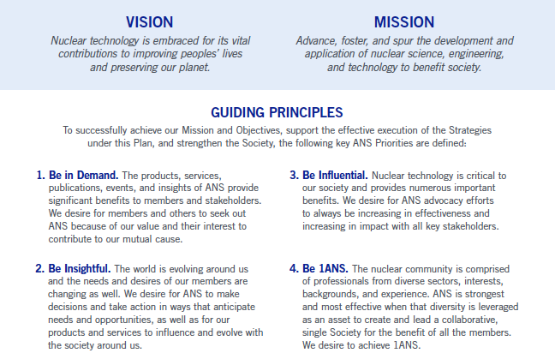
PRESIDENT’S REPORT
President’s report:
Emerging from COVID stronger
Change plan substantially implemented
Opportunity for continuing strategic planning and action

Slide 4
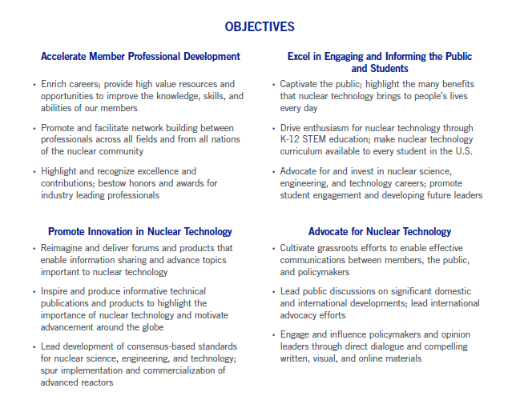

Slide 5
President’s report:
Emerging from COVID stronger
Change plan substantially implemented
Opportunity for continuing strategic planning and action
Active Professional Divisions Committee / solving problems
Net improvement to 2020 ANS financial position, despite pandemic
2021 budget will end with a net budget surplus
Sale of property in 2022 would add another $2M to the books
Continuing needs
  Grow membership and continue to improve benefits
  Grow philanthropy
  Deploy and expand K-12 programs
  Expand radiation communication activities
  Update bylaws
  Grow rapid response capability
  Raise awareness of clean nuclear energy

Slide 6
CEO REPORT
CEO report: emerging from COVID stronger
Stronger team
Understanding the new normal / in-person meetings
R&D report: thought leadership
Community has more influence in the field
Progress toward long term fiscal sustainability/more to be done
Tech stack replacement process commenced
Diversity, equity and inclusion / continued focus

Slide 7
Asset, Liability & Net Asset Trends 2010-2020

Slide 8
Revenues, Expenses and Net Asset Trends
2010-2020

Slide 9
Revenue & Expense Summary
Revenues & Expenses | 4/30/21 YTD Actual | 12/31/21 Forecast | 2021 Budget
Revenues | $2,601,199 | $9,215,826 | $8,345,779
Expenditures | $2,422,497 | $8,654,276 | $9,509,524
Surplus / (Deficit) before Investment Earnings | $177,703 | $561,550 | ($1,163,745)
Investment Earnings | $1,233,751 | $400,010 | $400,000
Overall Surplus / (Deficit) | $1,411,454 | $951,560 | ($763,745)
Notes:
Operating Revenue - Operating Expenses = Operating Surplus (Deficit)
Operating Surplus + Unrestricted items + Restricted items = overall surplus
Forecast includes recognition of both PPP loans.
Budget assumes in person Annual Meeting (which went virtual). RPSD and Actinides moved to 2022 and included in the budget. Removed from the forecast.

Slide 10
2021 Operating Forecast
 | Year End Projected 2021 (4/30/21) | Budget 2021 | $ Variance Forecast to Budget | % Variance
Revenue | $9,215,826 | $8,345,779 | $870,047 | 10.4%
Expenses | $8,654,276 | $9,509,524 | ($855,248) | (9.0%)
Net Surplus / (Deficit) before Investment Activity | $961,560 | ($763,745) | $1,725,305

Slide 11
MEETINGS
2020 Meetings
 | Budget | Actual
Meeting Revenue | $ 3,043,233 | $ 868,731
Meeting Expenses | $ 2,535,568 | $ 1,039,561
Net Surplus (Deficit) | $ 507,665 | ($152,955)
Meeting
Student Conference | Cancelled with penalty - $45,000 – postponed to 2021(deposit paid in 2020, carried over to 2021)
PHYSOR | Exercised force majeure option
NETS | Exercised force majeure option
TOFE | Exercised force majeure option (moved to embed in Winter)
AccApp | Cancelled with penalty - $60,370
Annual Meeting | Cancelled with penalty - $113,415.13 – virtual
UWC | Cancelled without penalty
ICRS 14/RPSD | Cancelled without penalty – rescheduled for 2021
Winter | Exercised force majeure option – virtual (TOFE Embedded)

Slide 12
MEETINGS
2021 Meetings
 | Budget | Actual
Meeting Revenue | $ 3,644,863
Meeting Expenses | $ 3,079,713
Net Surplus (Deficit) | $ 565,150
Includes Staff Labor
Meeting
CONTE | Cancelled without penalty – virtual
Student Conference | Cancelled without additional penalty from 2020 – virtual
Annual Meeting | Exercised force majeure option – virtual (NPIC&HMIT Embedded)
UWC | Planned to be in-person
ICRS 14/RPSD | Cancelled with penalty - $93,437.50 (rescheduled for 2022, 50% of cancellation fee will be applied to 2022 Meeting)
M&C | Planned to be in-person
PSA | Planned to be in-person
YPC | Separated from Winter Meeting due to date shift – virtual
Winter | Planned to be in-person (DESD Embedded) (AccApp Embedded)

Slide 13
INFORMATION TECHNOLOGY
Website Users
Notes:
In blue, the chart shows one year of web site user counts from April 15, 2020, which is the date the ANS web site redesign was launched. The redesign included the new Nuclear Newswire section, which is the first time the ANS site has had fresh, daily content to help drive more consistent traffic. The previous year is displayed in yellow, for comparison.

Slide 14
PUBLICATIONS
Weekly Newswire email statistics
First email on May 16, 2020 through April 2021
Notes:
The first weekly email was sent last May to roughly 5,000 members, that list was only

Slide 15
PUBLICATIONS
Nuclear Newswire Monthly Pageviews
Notes:
Views to ANS.org/news.

Slide 16
ADVERTISING
Online Ad Revenue 2018-2021*
Online ad revenue trends
ANS Website
Notes & Deadlines
Nuclear Newswire
*2021 revenue based on ads booked as of 5/26/21
YTD

Slide 17





COMMUNICATIONS
Earned Media
YTD
January 1, 2018 to May 28, 2021
Notes:
Excluded:
Awards, Hires, History and Obit stories
Non-ANS leadership (ex: “John Smith, a member of the American Nuclear Society.”)

Slide 18
COMMUNICATIONS
Social Media
  Median engagement rate for nonprofits is 0.063%

Slide 19
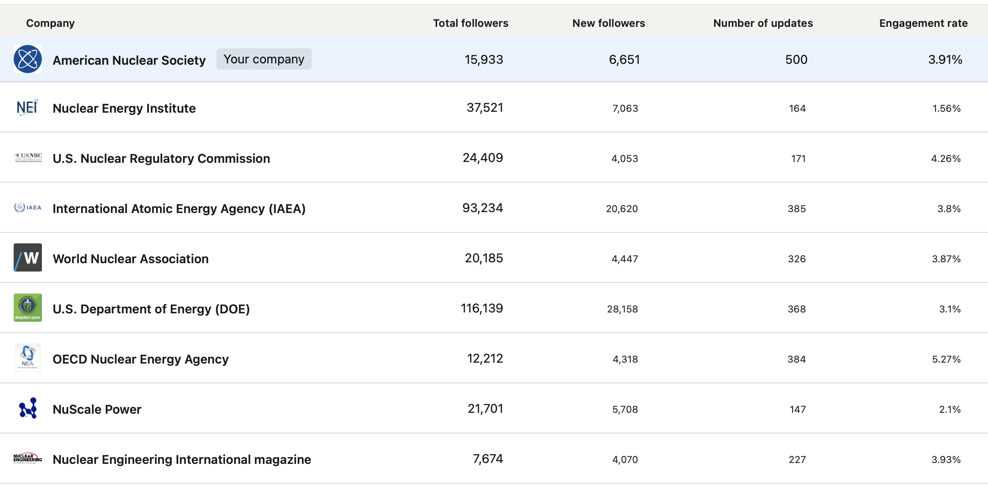
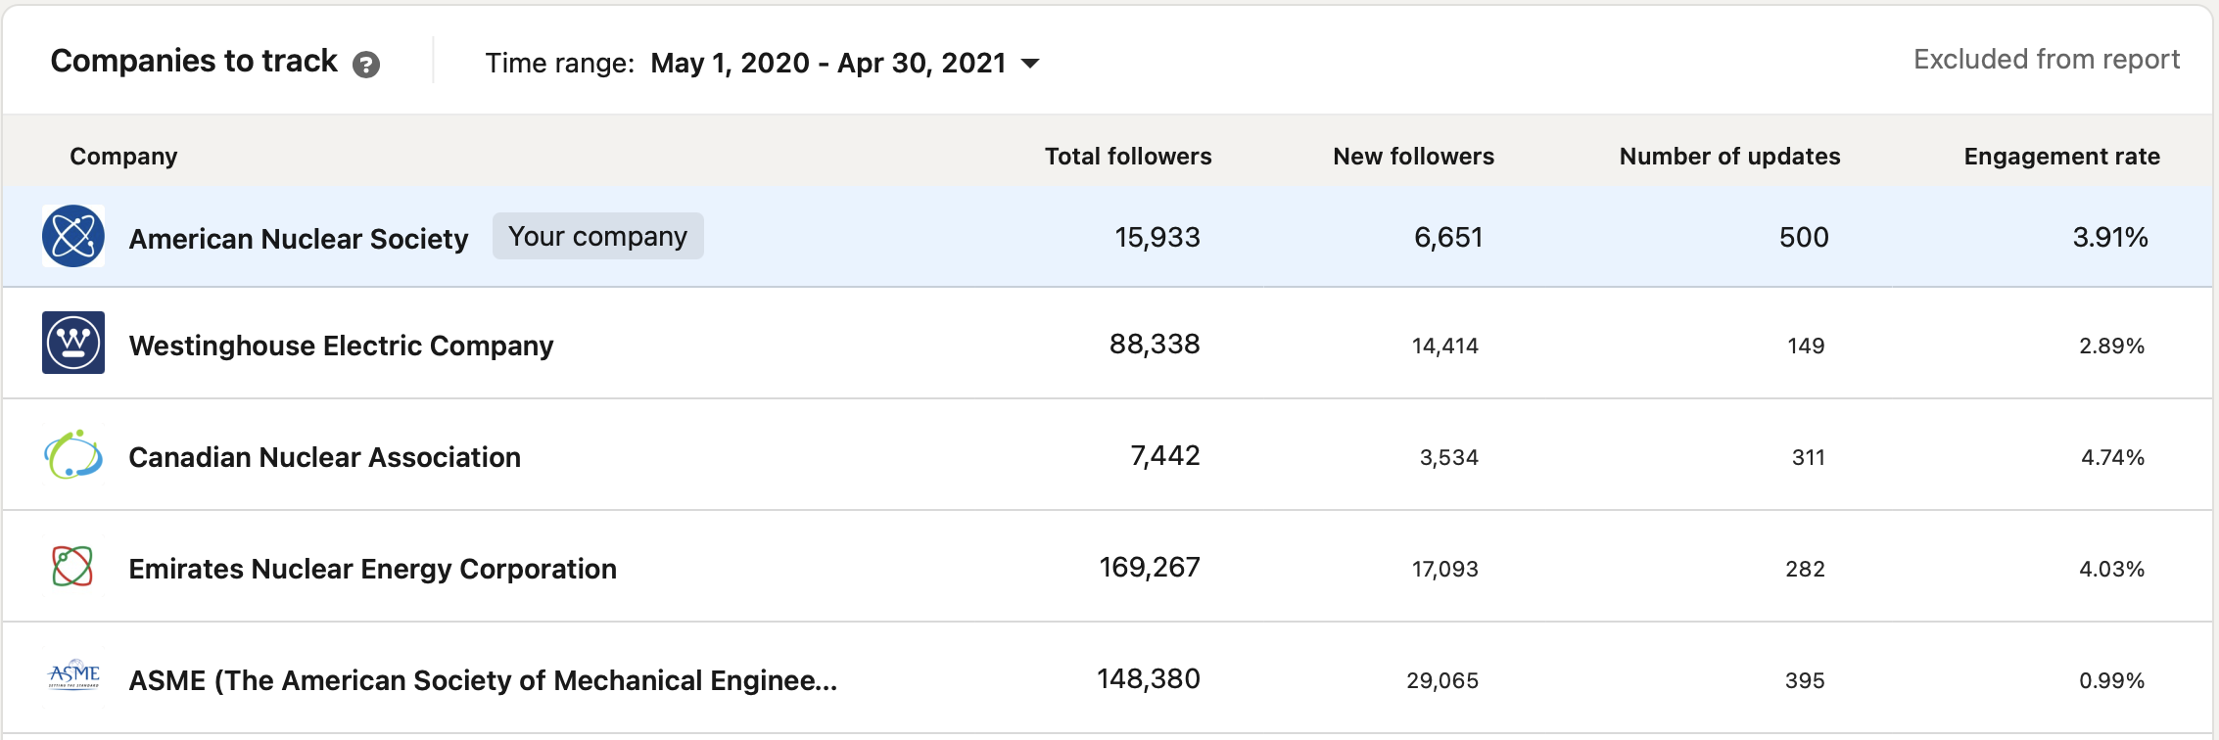
COMMUNICATIONS
LinkedIn Followers
  May 2020 to April 2021

Slide 20
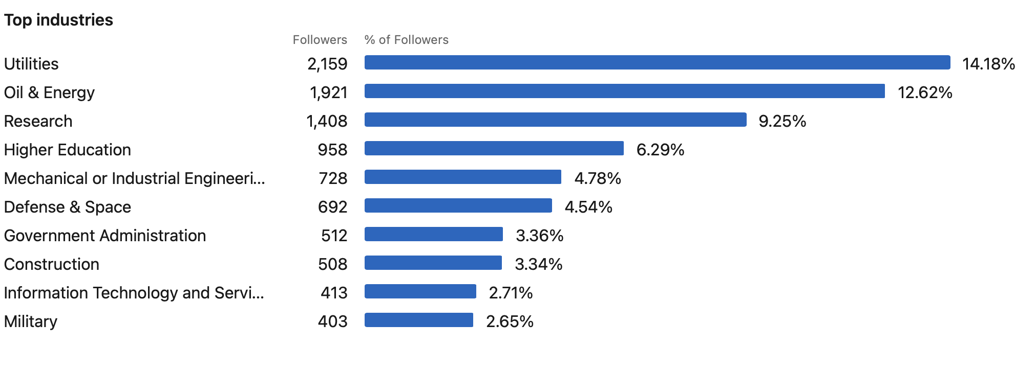
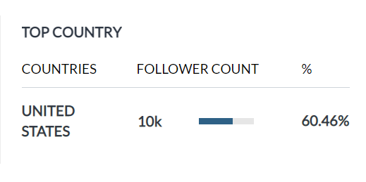
COMMUNICATIONS
LinkedIn Followers
  by Industry
  LinkedIn Followers by Industry

Slide 21
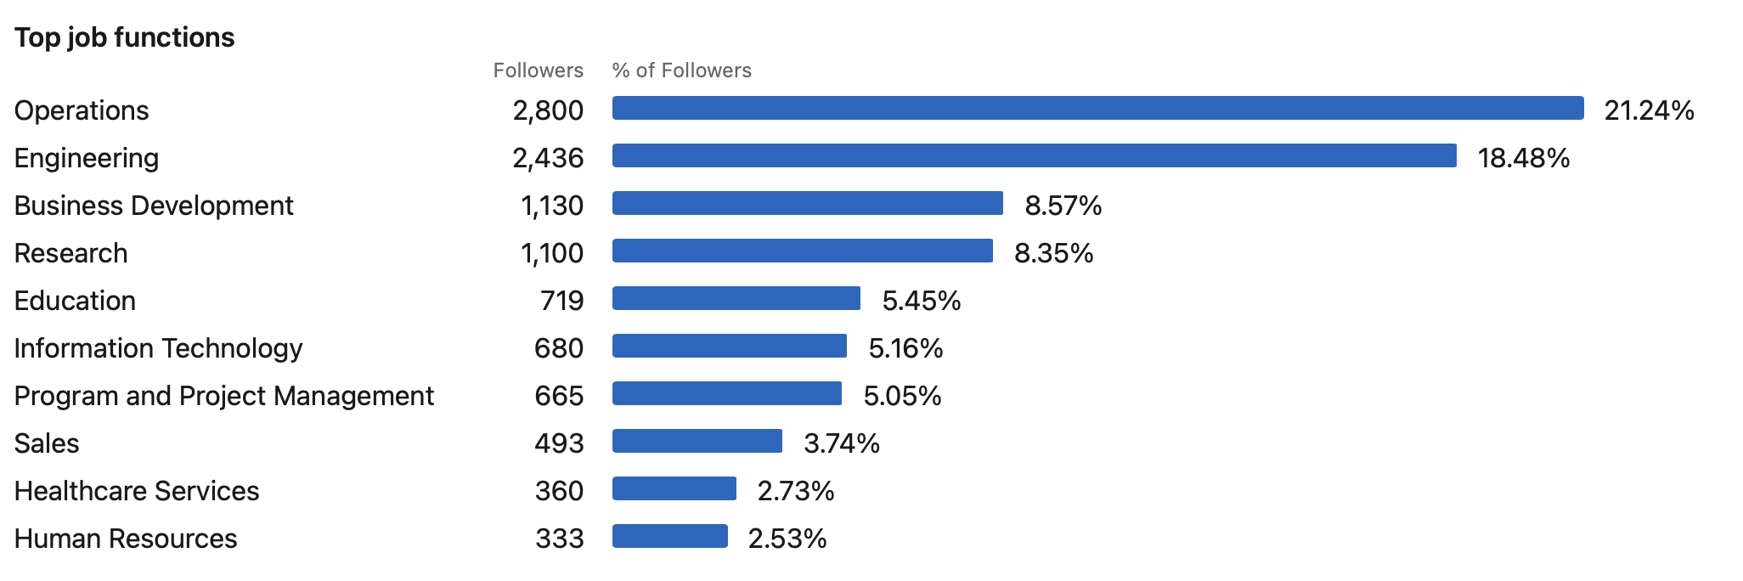
COMMUNICATIONS
LinkedIn Followers
  by Job Function

Slide 22
MEMBERSHIP
Membership Numbers
Category | April 2021 | April 2020 | Final 2020
Established | 3,638 | 3,528 | 3,956
Winter Meeting Trial Members | 1,103 | 0 | 1,147
Emeritus | 679 | 684 | 719
Young Members | 753 | 626 | 832
Recent Grad | 326 | 432 | 384
Students - Grad | 542 | 556 | 784
Students - Undergrad | 869 | 569 | 980
Lifetime | 579 | 519 | 565
Honorary Life | 146 | 161 | 152
Honorary Life NN | 712 | 724 | 723
TOTAL | 9,347 | 7,799 | 10,242
Note that memberships are now renewed based on anniversary date, so figures will fluctuate more than previous years.
Organization Members
2021 - 67 (As of May 20)
2020 - 74 (As of December 30)

Slide 23
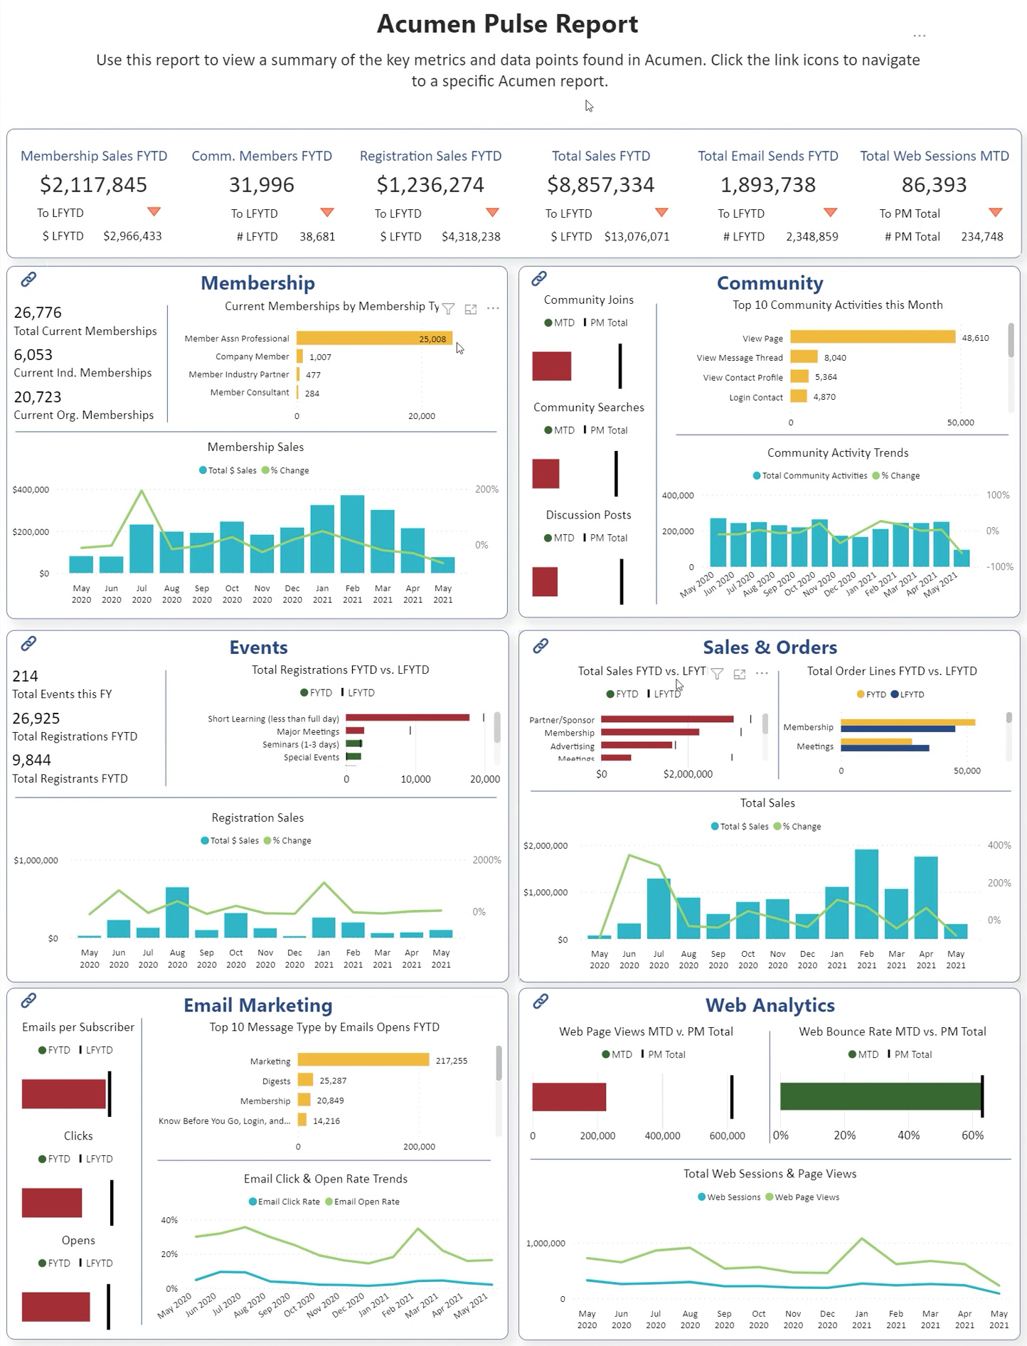

Slide 24
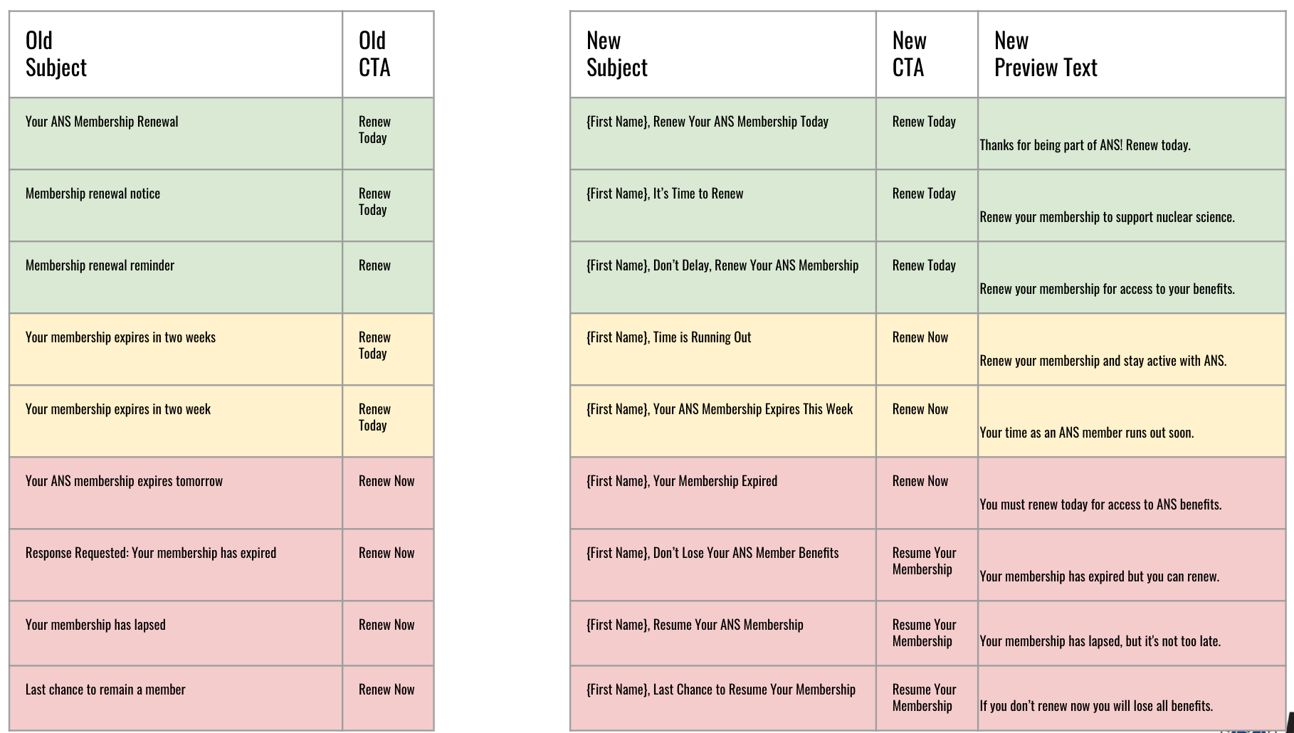
MEMBERSHIP
Membership Renewal Automation

Slide 25
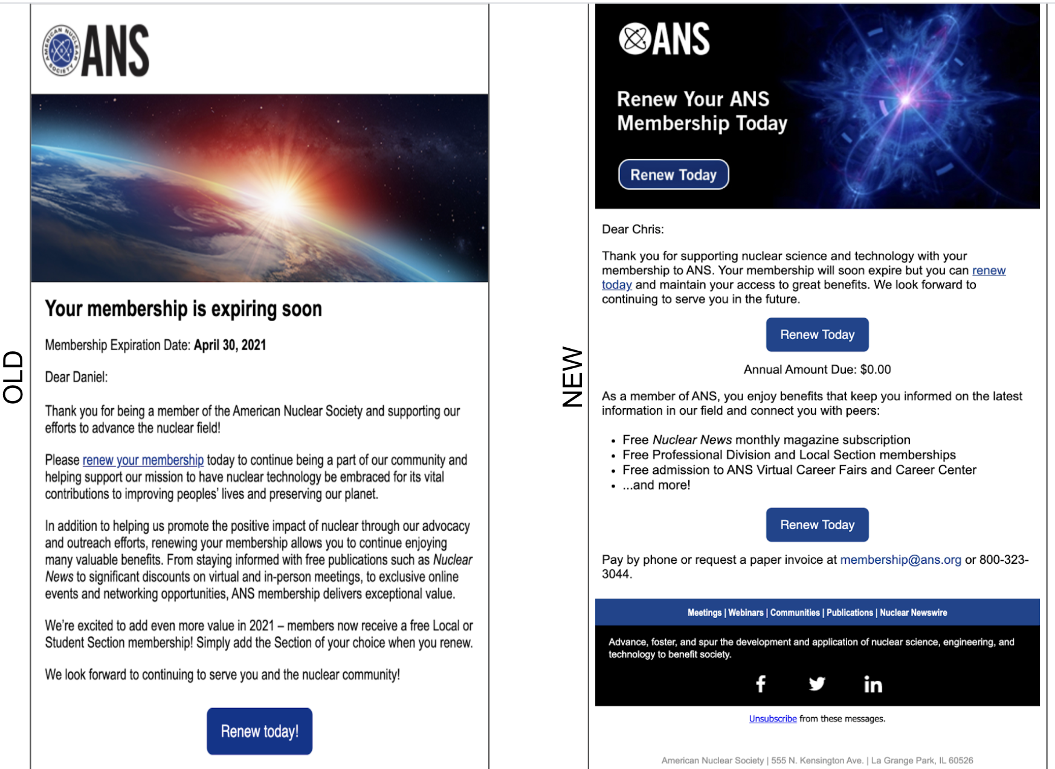
MEMBERSHIP
Renewal Automation Emails
OLD
NEW

Slide 26
Sale of LaGrange Property – Impact on ANS Assets
OPERATIONS
Impact on Unrestricted Net Assets: | $
Gross Sales Price | $ 2,500,000
Credits Given | ($350,000)
Commission | ($129,000)
Net Sales Price | $2,021,000
Less costs on Books:
Land | 114,000
Undepreciated Building Costs | 90,686
Net Gain on Sale | $ 1,816,314
Release Building Fund | 900,000
Total Increase to Unrestricted Net Assets: | $ 2,716,314

Slide 27
Leasing Cost Scenarios
OPERATIONS
 | (27,000 sf) | (7,500 sf) | (10,000 sf)
Annual Costs: | Current | Low Range | High Range
Office Space | $ 323,441 | $ 198,524 | $ 317,500
Storage Space |  | 3,840 | 3,840
Total Annual Costs | 323,441 | 202,364 | 321,340
Total Term (11 Years) | 3,557,851 | 2,226,004 | 3,534,740
One-time costs:
Moving Costs |  | 20,000 | 20,000
Total Costs | $ 3,557,851 | $ 2,246,004 | $ 3,554,740
Difference from current scenario |  | (1,311,847) | (3,111)

Slide 28
DEVELOPMENT
2021 Fundraising Campaign
Launch Summer 2021
2021 Goal $650,000
Target
Support for Nucleus: Center for the Advancement of Nuclear Science and Technology
K-12 activities expansion / Nuclear in Every Classroom
Radiation Communication / A Dose of Reality
Workforce development/diversity
Donor Base
Foundation and government entities – Grants and awards seeking support for specific strategic initiatives
Corporate – Primary prospects include companies that have a history of large philanthropic gifts to the original CNSTI fundraising campaign and/or to the Navigating Nuclear appeal
Individual – Primary prospects (via a direct mail solicitation) include high wealth ANS members, Legacy Circle donors, and Honors and Awardees

Slide 29
GOVERNANCE
Governance 2020-2021
Bylaws were voted upon by membership and changed to include
Young Member Director language from the Change Plan 2020
The ANS National Election certified results account for 2,220 ballots cast from 10,245 eligible members, yielding a participation rate of 21.67%
New red-line Change Plan 2020 created and now working with the Bylaws & Rules Committee to ensure any additional bylaws changes are completed for a membership vote by ANS National Election 2022

Slide 30
Thanks/Questions

Slide 31
DEVELOPMENT
Year-End Goal
CNSTI $45,309
General $666,830
Total $712,139
YTD REVENUE
CNSTI $20,984
General $30,651
Total $51,635
Development Department Revenue September 2017-May 2021: $2.4 million
January 1 - April 30, 2021

Slide 32
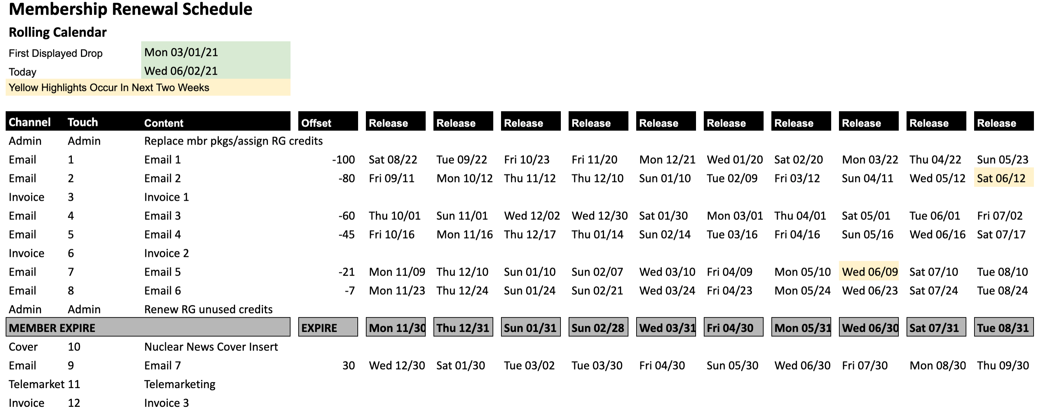
MEMBERSHIP
Membership Renewal Automation

Slide 33
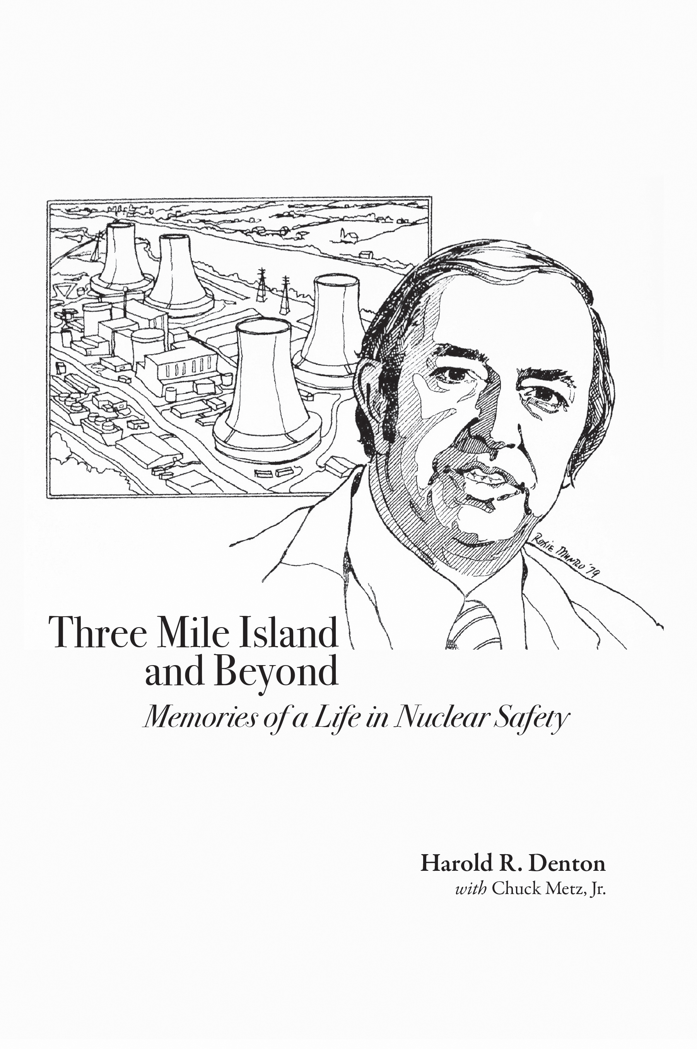

PUBLICATIONS
Two New Books Published
Three Mile Island and Beyond
  Includes Denton’s retelling of the accident with chapters conveying his career-long message of safety being the paramount factor in the use of nuclear technology.
Light Water Reactor Materials
Volume II: Applications
  Textbook describing the behavior of nuclear materials during service in light water reactors.
Notes:
Sam Walker quote:
“Harold Denton won national, and indeed, worldwide acclaim for his role in responding to the Three Mile Island accident in 1979. His memoir is a fascinating account of the trials and tensions of dealing with that crisis. It is also a thoughtful reflection on the challenges he faced and principles he applied during his career as a prominent nuclear regulator. The book is a must-read for anyone interested in the past and the future of nuclear power.”
—J. Samuel Walker, author, Three Mile Island: A Nuclear Crisis in Historical Perspective

Slide 34
MEMBERSHIP
2021 Key Membership Growth Priorities
Retention
Change from calendar to anniversary renewal cycle
Email automation to increase efficiency and effectiveness
Continuing to send mailed invoices and phone outreach
Recruitment
Recruitment campaign to launch in June
Content marketing to leverage Nuclear Newswire weekly email
Change Plan discounts for Student/Local Section members
Nonmembers national meeting attendees to receive free memberships
Engagement
Increase awareness and use of member benefits
Track member engagement to improve communications

